Slide 1
NCryptfs
A Secure and Convenient Cryptographic File System

Slide 2
Motivation
Securing data is crucial
  Millions of dollars lost due to breaches
  Data is irreplaceable and sensitive
Software to secure data not in wide use
  Inconvenient and Unintuitive
  Conflicts with other software
Our primary goals
  Ensure data confidentiality
  Security, Convenience, and Performance

Slide 3
Threat Model (Laptop)
Application
Cleartext
Application
NCryptfs
Ciphertext
File System
File System
Hard Disk
Hard Disk

Slide 4
Threat Model (NFS)
Application
Cleartext
Application
NCryptfs
CLIENT
Ciphertext
NFS Client
NFS Client
Network
Network
NFS Server
NFS Server
SERVER
Disk Based File System
Disk Based File System

Slide 5
Related Work
CFS
  User-level NFS server
  Very portable
  Network/Data Copy Overhead
TCFS
  Kernel-mode NFS client
  Works with any NFS Server
  Network Overhead
BestCrypt
  Kernel-mode loop back device
  Simple interface, good performance
  Loses per-file information

Slide 6
Related Work (cont’d)
EFS
  Windows NT extension to NTFS driver
  Well integrated into kernel and GUI
  Only one file system and OS
StegFS
  Not only ensures confidentiality, but also employs steganography
  Poor performance (up to factor of 200)
Cryptfs
  Precursor to NCryptfs
  Portable kernel-mode stackable file system
  Simple proof-of-concept file system

Slide 7
Design Goals
Security
  Use strong encryption to keep data confidential
Convenience
  Three groups:
    Users
    System Administrators
    Programmers
Performance
  Designed as a kernel-space file system
Portability
  Using stackable file systems as a basis

Slide 8
The Players
System Administrator
  Trusted to install NCryptfs
  Not trusted with encryption keys
Owners
  Control the encryption key
Readers and Writers
  Do not have the encryption key
  Can delegate permissions
  The owner is implicitly a reader or writer

Slide 9
Basic Usage
/home/mike/secrets
/mnt/ncryptfs/mike
g©2`è°¦N,ÚÂíá¼±f´
|×É`¹m
This is a secret. Please don't tell.
Encrypting
Decrypting
ZJ8HxPh+K6Nx9bCqUJ-q9gMl
foo.txt

Slide 10
System Architecture
Stackable file system implementation
  Based on Cryptfs from FiST
  Works with any low-level file system
  Transparent to applications
  Cipher agnostic
Kernel changes for security
  Process on-exit callbacks
  Cache cleaning
Linux 2.4 prototype (2.4.18 – 2.4.20)

Slide 11
How Stacking Works
User process
System Call
Interface
USER
read()
data &
error codes
ncryptfs_read()
NCryptfs
KERNEL
File System
Interface
ext2fs_read()
data &
error codes
EXT2FS

Slide 12
Name Space Conflicts
foo
bar
K1
K2
K3
Ciphertext A
Ciphertext B

Slide 13
Attaches
Associates a lower-level directory to a name within NCryptfs
  Ex: /mnt/ncryptfs/mike attaches to /home/mike/secrets
Like a user-mode mount
Separates name space (no dentry conflicts)
Scalable, doesn’t require root privileges
Each attach has private data
  Encryption Key
  Authorizations
    Permissions, Scope, and Authentication Criteria
  Active Sessions

Slide 14
Permissions
Authorizations and Active Sessions
  Read, Write, and Execute
  Detach
  Add an Authorization
  List Authorizations
  Delete an Authorization
  Revoke an Active Session
  List Active Sessions
  Bypass VFS Permissions
Mount points have two additional permissions
  Attach
  Authenticate

Slide 15
Timeouts
Keys, Authorizations, and Active Sessions
Options on timeout:
  All operations fail
  Opening a file fails
  All operations block (sleep)
  Opening a file blocks
A user-space helper program can be called to execute on timeout
  e.g., integrate into graphical file browser

Slide 16
Groups
Standard UNIX Groups
  Supported as a first class entity, like a user
Ad-hoc Groups
  Add multiple authorizations for each entity
  No system administrator intervention required
  But: by default NCryptfs respects the lower-level file system’s permissions

Slide 17
Bypass VFS Permissions
UID=CPW
User process
USER
unlink()
data &
error codes
User CPW Permitted?
ncryptfs_unlink()
NCryptfs
Permission Check
KERNEL
nc_preop()
nc_fixup()
ext2fs_unlink()
data & error codes
EXT2FS
Permission Check
UID==Owner?

Slide 18
On-Exit Callbacks
Expunge private user info on process exit. Advantages over alternatives:
  Efficiency: no periodic scans of lists
  Security: no gap between process death and cleanup
NCryptfs uses on-exit callbacks to
  purge active sessions and authorizations
  challenge-response authentication
    the task-private data creates a session between a user process and the kernel

Slide 19
Cache Cleaning
Cleartext information is left in page, inode, and dentry caches
  Improves performance
  But: leaves cleartext information available to an attacker
Periodically expunge private information
  Pages
    All pages are evicted
  Inodes and Directory entries
    Unused inodes and dentries are evicted

Slide 20
Evaluation
Compare CFS, TCFS, BestCrypt, and NCryptfs
Null mode and 128 bit Blowfish Encryption
Test Platform
  Linux 2.4.18 for CFS, BestCrypt, and NCryptfs
  Linux 2.2.17 for TCFS (latest available)
  1.7Ghz Pentium IV
  128 MB of RAM
  Western Digital Caviar 30 GB 7200RPM IDE Disk
Each test was run 10 times with an observed standard deviation of less than 5%

Slide 21
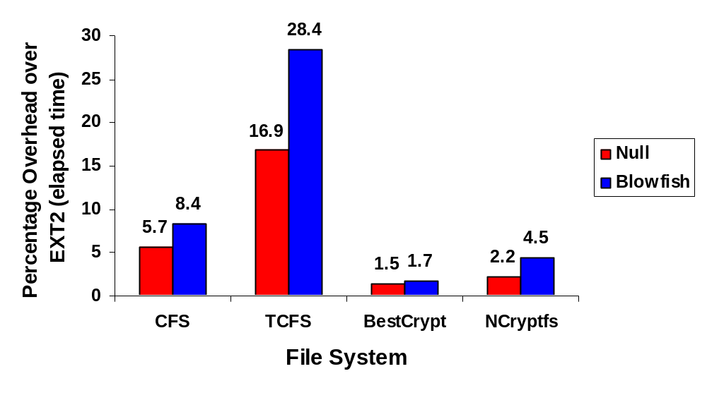
Performance – General Purpose
Am-Utils Compile: Model User Behavior

Slide 22
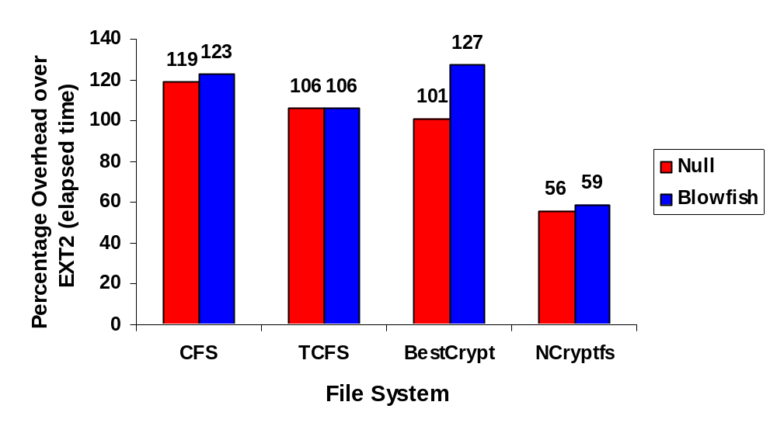
Performance – I/O Intensive
Postmark: Simulates Busy Mail Server

Slide 23
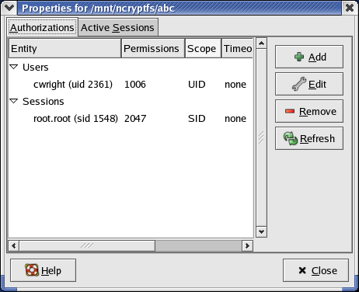
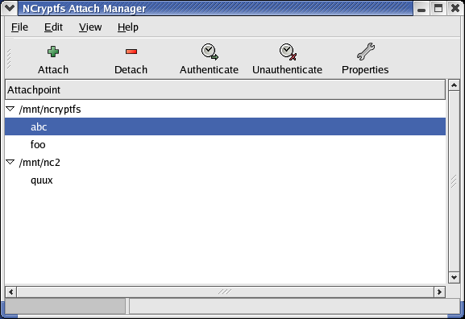
Current Status
Data integrity assurance
GUI Management Tool

Slide 24
Future Work
Key management
  Lockbox Mode
  Centralized Key Servers
  Threshold secret sharing
Protecting metadata
Expand kernel event mechanisms
  e.g., trap setuid changes
Centralized stacking-aware cache manager

Slide 25
Questions?
NCryptfs: A Secure and Convenient Cryptographic File System

Slide 26
System Components
Application
Application
Application
Linux Kernel
On-Exit Callback
Caches
Blowfish
VFS
AES
NCryptfs
EXT2FS
NFS
3DES
…

Slide 27
Scope of Kernel Changes
Task on-exit callback
  New Kernel Source File:165 Lines
  Kernel Patch: 164 Lines
Cache Cleaning
  Kernel Patch: 141 Lines

Slide 28
Filename Encryption
MD5-32
Type
Filename
4 Bytes
1 Byte
N Bytes
Key
Cipher
Encrypted Filename
5+N Bytes
Base64 Encoding
Base64 Encoded Filename
ceil((4/3)*(5+N)) Bytes

Slide 29
NCryptfs vs. LSM
LSM provides authorization and accounting hooks before and after operations (VFS, networking, etc.)
LSM Modules implement an access control policy using a subset of these hooks
  SELinux, LIDS, etc.
LSM does not deal with caches
Requires intercepting all operations

Slide 30
Bypass VFS Permissions
User process
USER
unlink()
data &
error codes
ncryptfs_unlink()
KERNEL
NCryptfs
Permission Check
nc_preop()
nc_fixup()
ext2fs_unlink()
data & error codes
EXT2FS
Permission Check

